Slide 1

Presented By:
G.R. Rohith
Abhinav Sandru

Slide 2
Problems
Addressed
Accidents are informed late due to which more lives are lost.
Many accidents end up victim to death because of the delay in locating the victim, identifying him and informing to his/her family members.
Location tracing takes time.
Informing the close ones usually depends on the victim or the bypassers
Rash driving is common among the youth and often parents are unaware

Slide 3

Flex Cap
An Accident Detection Helmet

Slide 4
Solutions Proposed
Adding a flexible sensor to the helmet that detects change in pressure and hence the accident
Sending a message to the family to inform using GPRS Module
Giving a missed call on the family member’s number to ensure quick action
Sending the exact location of the accident using GPS Module

Slide 5
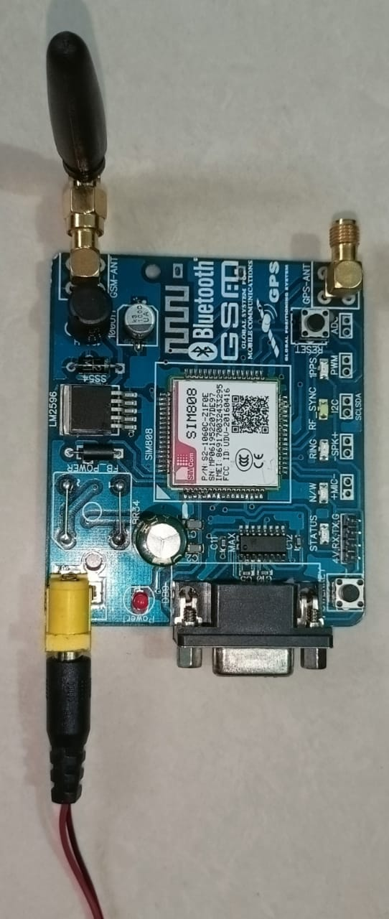
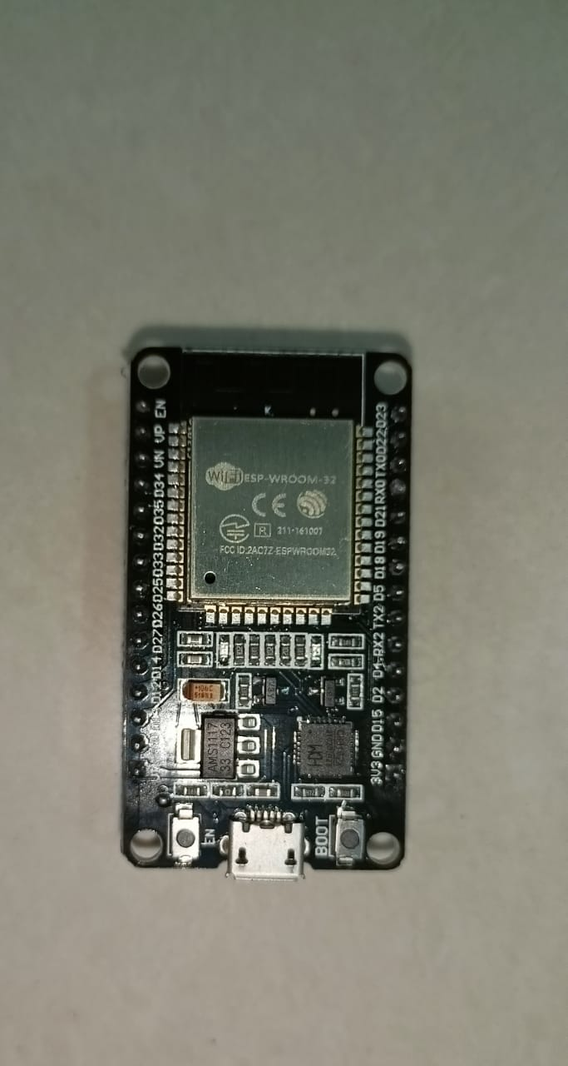
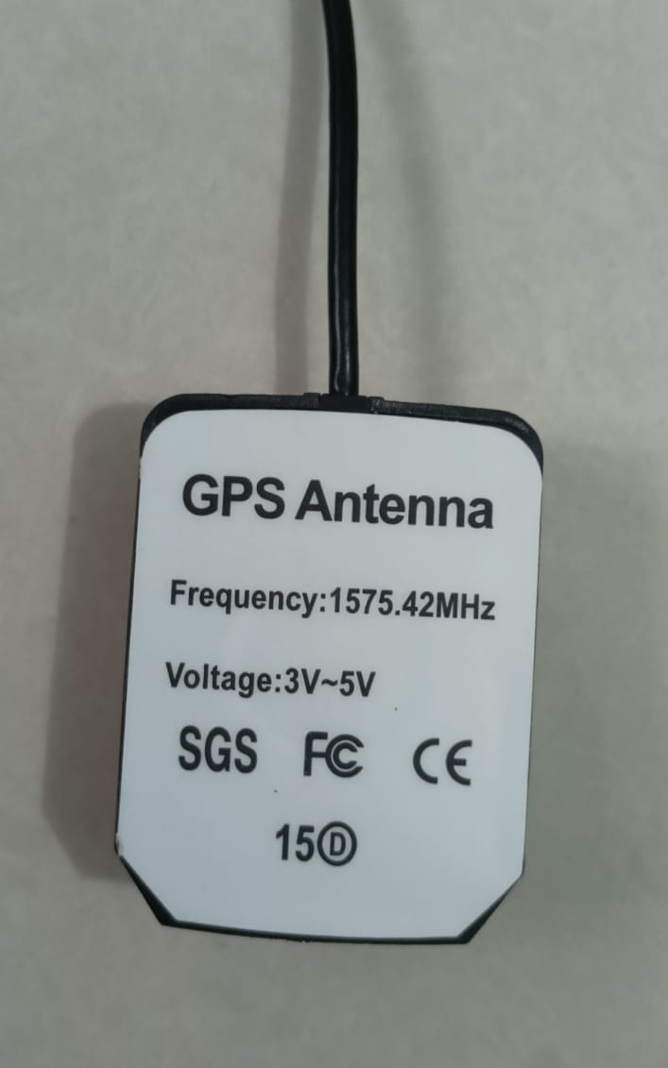
Components Used
ESP32 Module
sim808-GPS/GSM Module
Velostat
1㏀ resistors
Connecting wires
Helmet
GPS Antenna
GSM Antenna

Slide 6
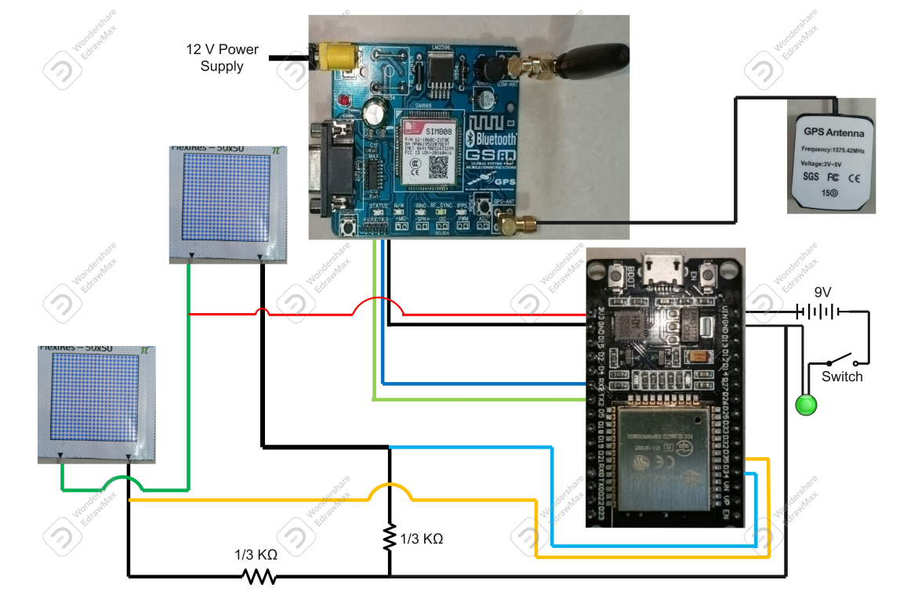
Circuit

Slide 7
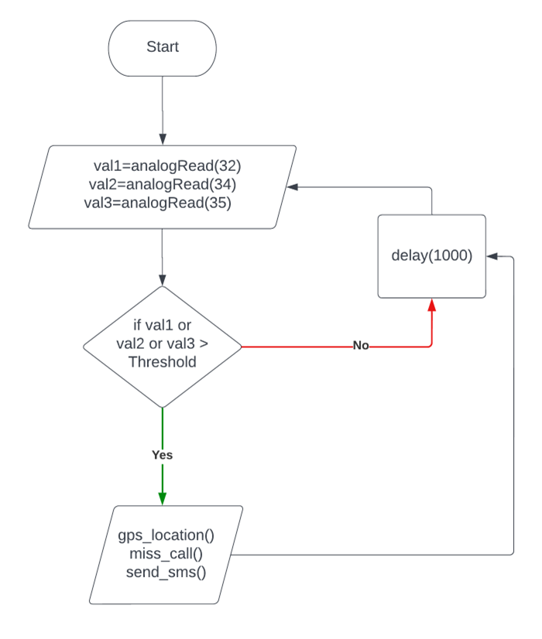
Flowchart

Slide 8
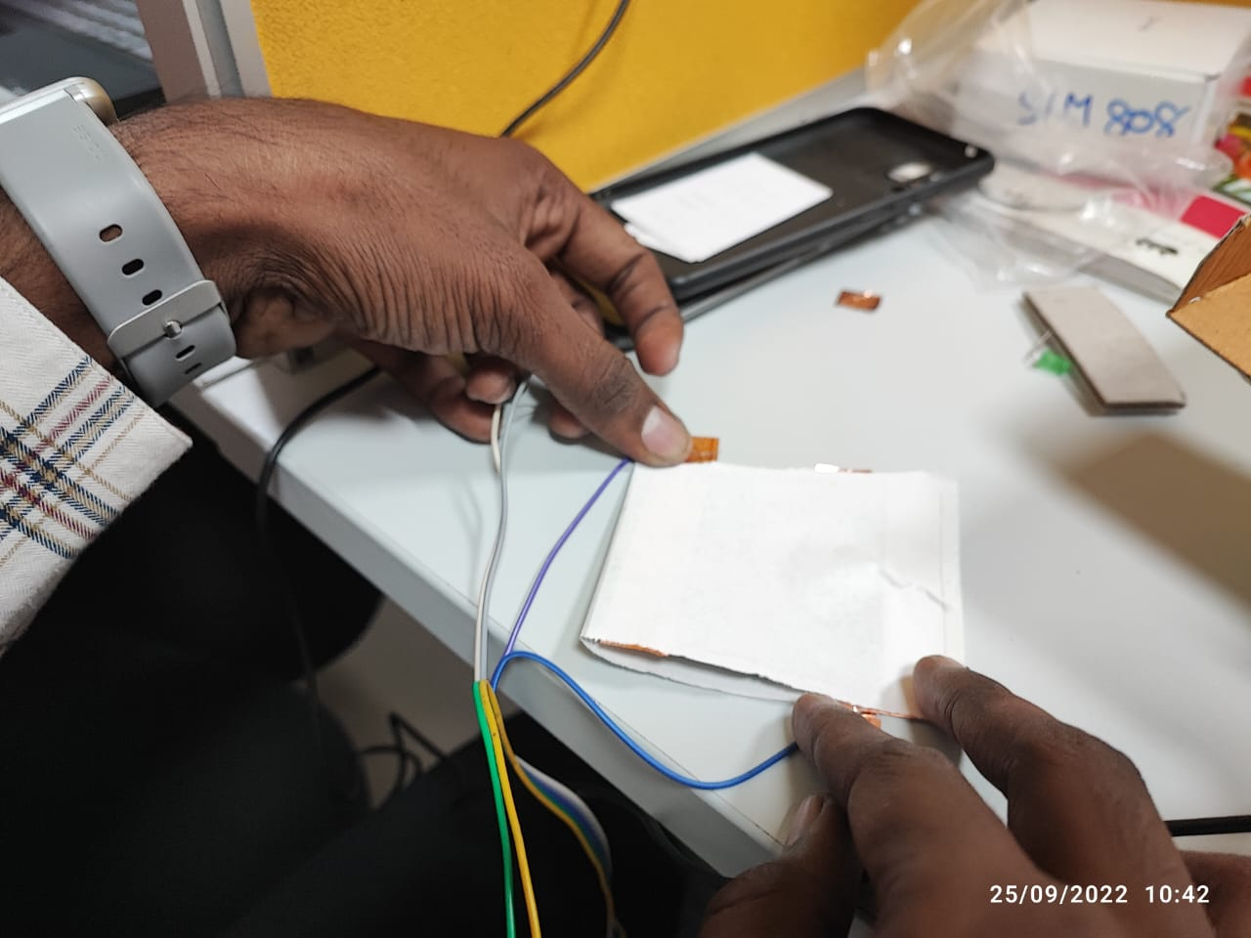
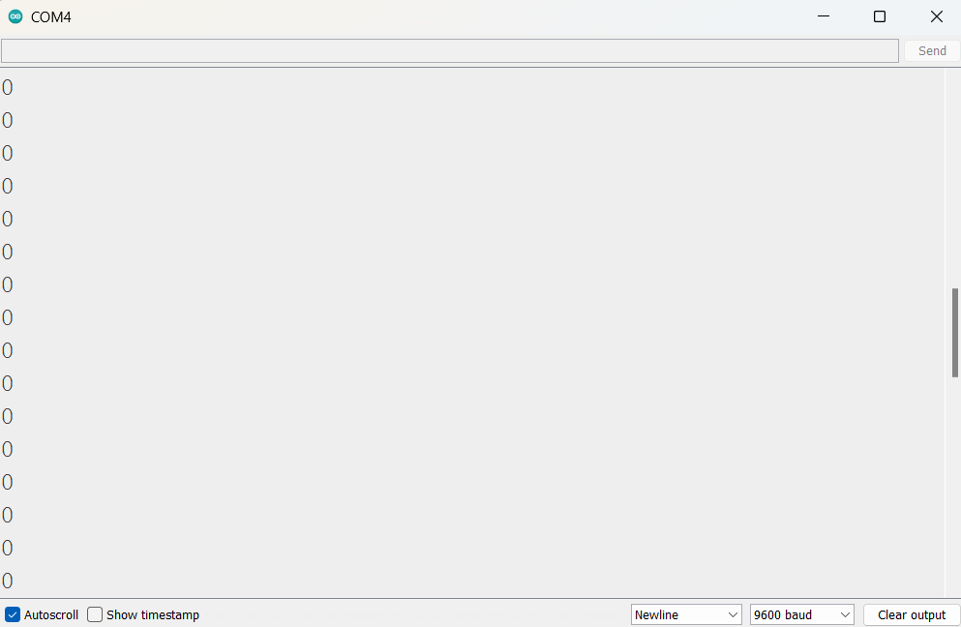
No Pressure Applied

Slide 9
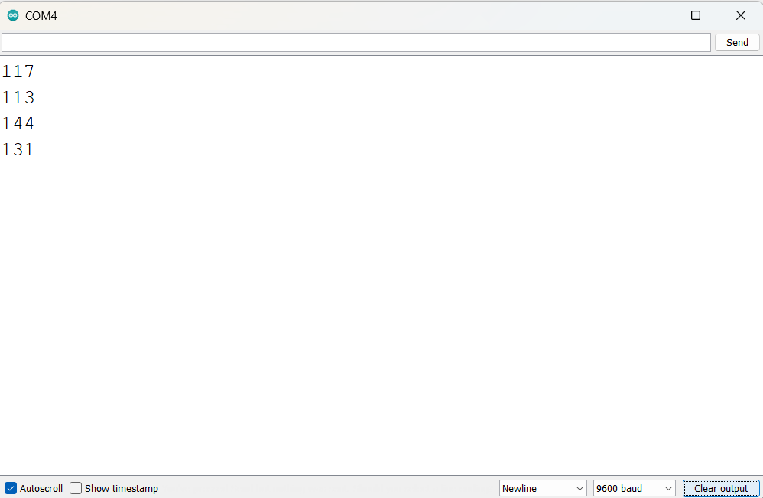
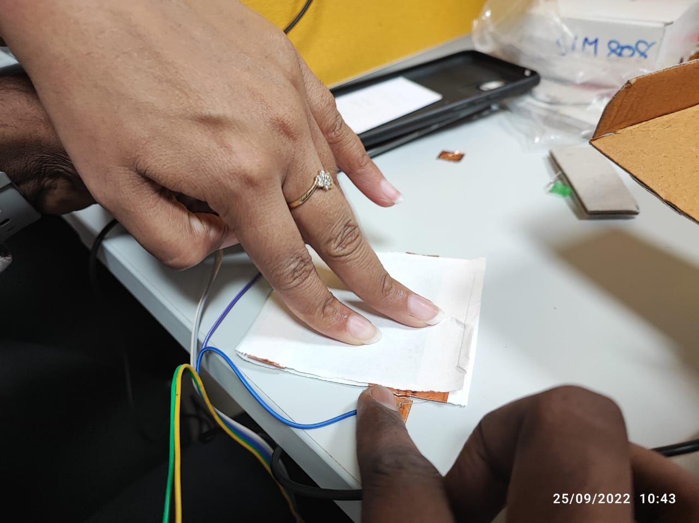
Pressure Applied

Slide 10
Calibration and Deciding Threshold
For the purpose of the product, sensors are needed with lower sensitivity so that false positives can be reduced
Out of the 2 available sensors, Velostat is found to have lower sensitivity than FlexiRes
Experimenting with the values of Rb, it is found that lower Rb leads to decrease in the sensitivity, so Rb=(1/3)㏀ is chosen
Pressure is applied through various ways to note the analog readings and decide on a threshold value

Slide 11
Demonstration Video
Click Here for the Demonstration video

Slide 12
Future Scope
Rash driving is common among the youth and often parents are unaware. Alert the parents on occasions of exceeding speed limits.
Develop similar technology for car safety by using seat belts and air bags
Make the circuit compact for better scalability and ease of use
Work on making other safety gears also smart
Design helmets of different sizes and shapes for use by different transport drivers like bicycle, scooter, motorcycle
Develop a dashboard for the police to view accidents data on a map.

Slide 13
Thank You!

